Slide 1

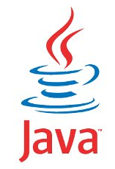
JAVA SE
(Core java)
Lecture 2

Slide 2

Today’s Agenda
Moving Ahead with JAVA
Editions Of Java
Difference Between JDK,JRE and JVM
Downloading JDK
Installing JDK
Verifying The Installation

Slide 3
Editions/Flavours Of Java
When Java was originally released in 1996, it was just Java and no such thing as “editions” was there.
But as use of Java increased , then in 1999 , SUN categorized it into 3 editions called J2SE,J2EE and J2ME .
Later on in 2006 they changed the naming and called them as JSE,JEE and JME.
These editions were named based on the kind of application which can be developed by learning that edition.

Slide 4
JSE(Java Standard Edition)
This is the most basic version of Java and it provides us core concepts of Java language like the data types , operators, arrays, methods , OOP , GUI (Graphical User Interface ) etc.
Since it teaches us core concepts of Java that is why many people call it CORE JAVA , although SUN never gave this name.
Used for developing desktop applications like calculators, media player, chat applications etc

Slide 5
JEE(Java Enterprise Edition)
The Java EE which stands for Java Enterprise Edition is built on top of the Java SE platform and is a collection of libraries used for building "enterprise applications" (usually web applications).
In simple terms we can say JEE is used for developing applications which run on servers.
Some popular applications developed using JEE are amazon.in,alibaba.com,irctc.co.in,ideacellular.com,airtel.in etc

Slide 6
JME(Java Micro Edition)
Java ME is the slimmer version of Java targeted towards small devices such as mobile phones.
Generally people tend to think of the micro edition as the mobile edition, in reality, the micro edition is used not just for mobile phones, but for all kinds of devices, such as television sets, printers, smartcards and more.
But as smartphone technology arrived the use of JME has reduced as Android has superseded it.

Slide 7
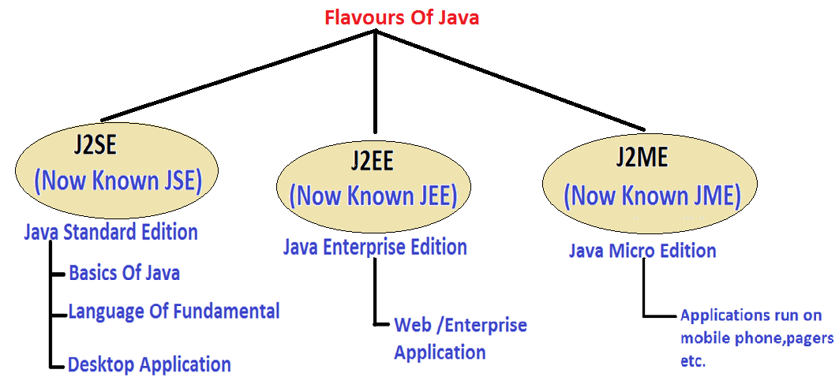
Java Editions

Slide 8
JDK v/s JRE v/s JVM
Understanding difference between JDK,JRE and JVM is very very important in java for interviews
These terms stand for:
JDK: Java Development kit
JRE: Java Runtime Environment
JVM: Java Virtual Machine

Slide 9
What Is JVM ?
JVM is an abstract machine that can execute precompiled Java programs.
In simple terms it is the code execution component of java
It is designed for each platform(OS+CPU) supported by Java and this means that every platform will have a different version of JVM

Slide 10
QUIZ
Why JVM is called a virtual machine ?
JVM is called virtual machine because it is a software layer but it
behaves as if it is a complete machine(platform).
That is all the tasks which are done by a machine while running a
program in other languages like C , are actually done by JVM in Java .
For example:
Starting The Execution By Calling Main( )
Allocating Memory For The Program
Cleaning Up Memory cleanup etc

Slide 11
What JVM Contains?
JVM contains following important components
Interpreter
Garbage Collector

Slide 12
QUIZ
Are java compiler and interpreter same?
No , not at all.
The Java compiler converts source code to bytecode and is not a
part of JVM , rather it comes with JDK.
The interpreter lives inside the JVM and converts bytecode to
Machine understandable form

Slide 13
What Is JRE ?
JRE is an acronym for Java Runtime Environment
It contains a JVM along with java classes/packages and set of runtime libraries.
So the JVM , while running a java program uses the classes and other libraries supplied by JRE.
If we do not want to write a java program , and we just want to run it then we only need a JRE
Notes:
time

Slide 14
What Is JDK ?
JDK stands for Java Development Kit and is a bundle of software that we can use to develop Java based applications.
It includes the JRE, set of library classes, Java compiler,jar and additional tools needed while developing a Java application.
Notes:
time

Slide 15
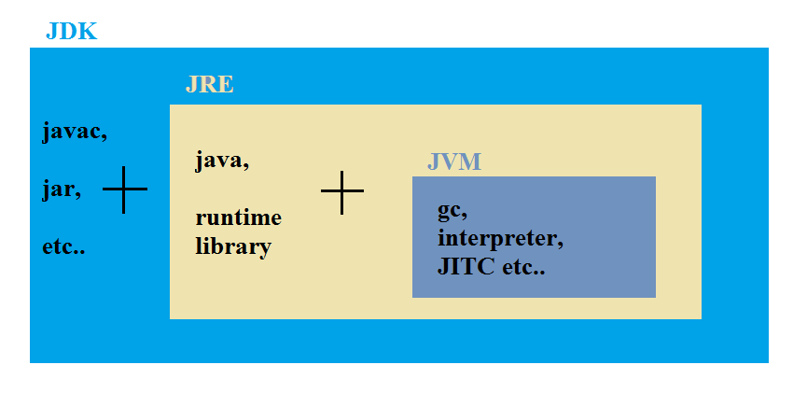
JDK,JRE and JVM
Notes:
time

Slide 16
QUIZ
Can I compile a java application if I have a JRE ?
Yes
No
Correct Answer: No
JRE can only be used to run a Java application . It doesn’t contain the javac tool which is used for compilation

Slide 17
QUIZ
Which component is used to compile, debug and execute java program?
A) JVM
B) JDK
C) JIT
D) JRE
Correct Answer: B

Slide 18
QUIZ
Which component is used to convert bytecode to machine specific code ?
A) JVM
B) JDK
C) JIT
D) JRE
Correct Answer: A

Slide 19
QUIZ
Which component is used to provide a platform to run a java program ?
A) JVM
B) JDK
C) JIT
D) JRE
Correct Answer: D

Slide 20
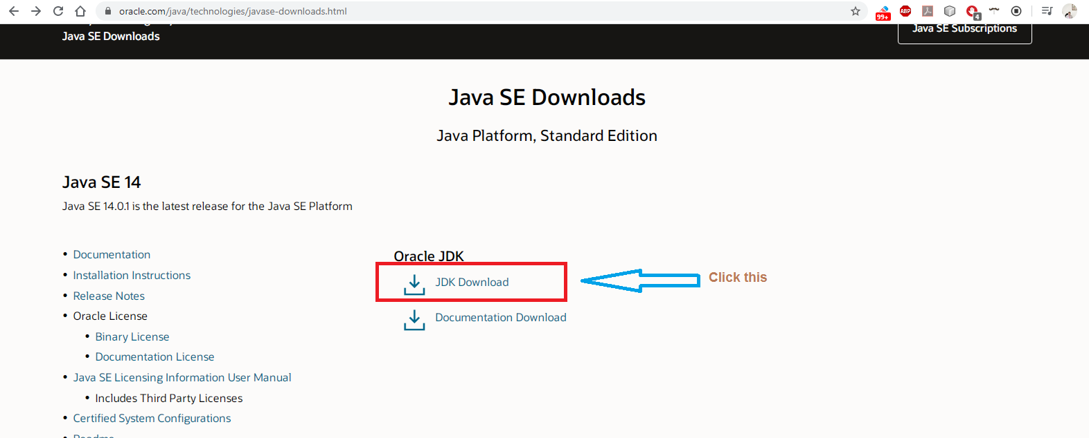
Downloading JDK
STEP 1: Go to http://www.oracle.com/technetwork/java/javase/downloads/index.html

Slide 21
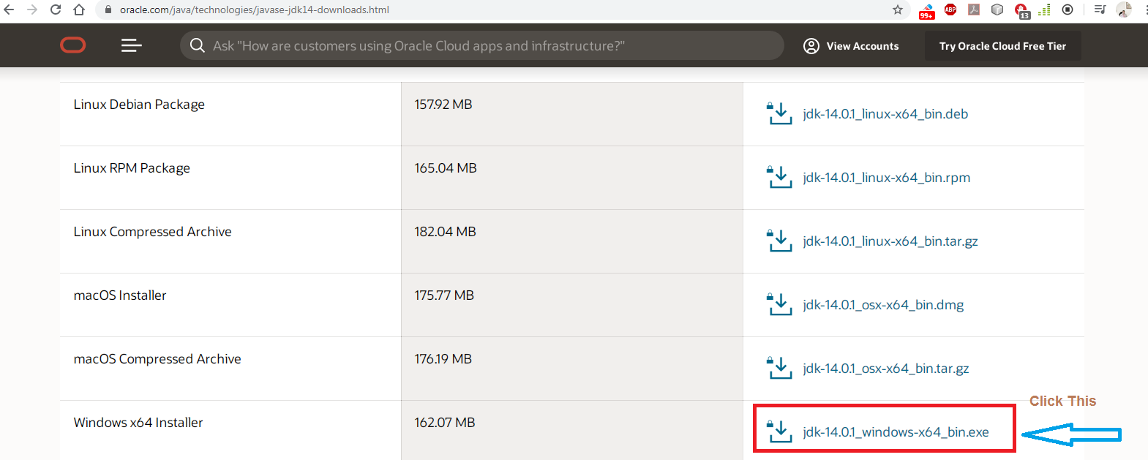
Downloading JDK
STEP 2: Select JDK according to your OS.

Slide 22
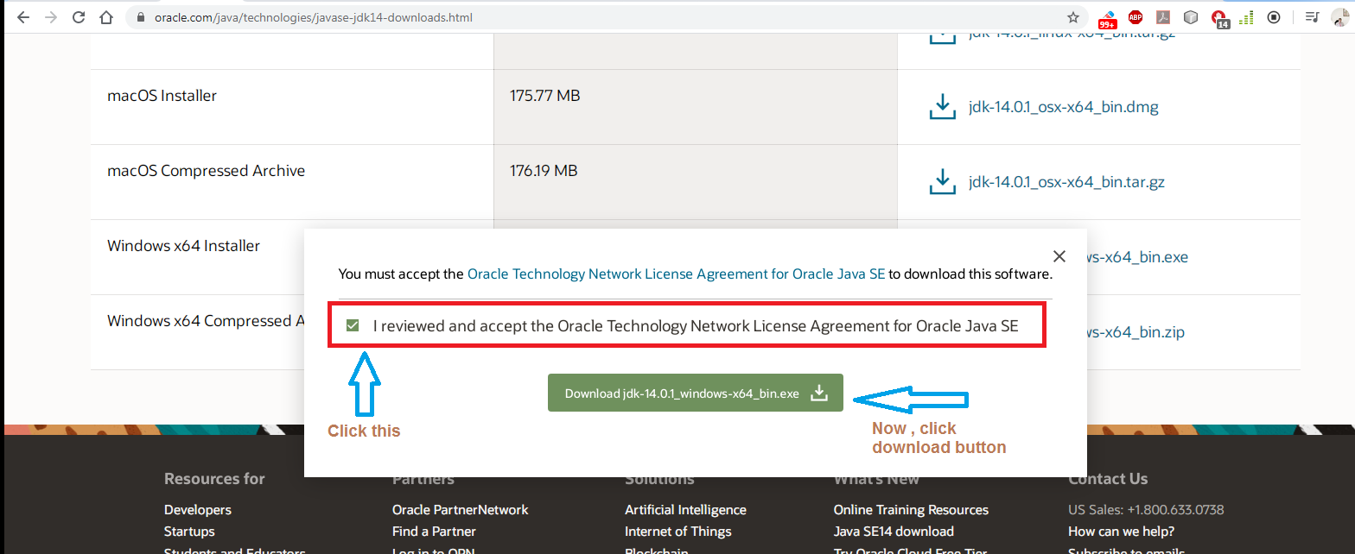
Downloading JDK
STEP 3: Accept License Agreement

Slide 23
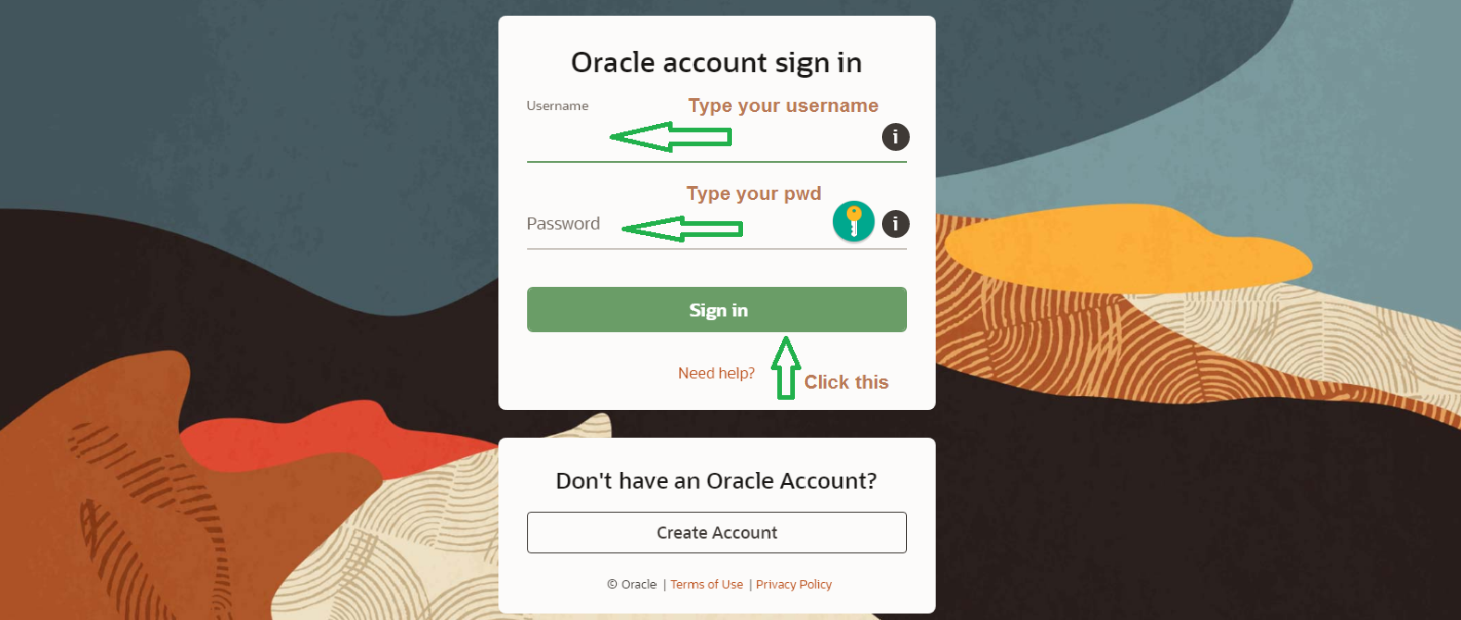
Downloading JDK
STEP 4: You will be asked to login. So login to your Oracle account

Slide 24
Installing JDK
The download will begin .
When the download completes, you will get an exe file called jdk-14.0.01_windows-x64_bin.exe
Now, right click on this exe file and "Run as Administrator".
An installer window will pop up.

Slide 25
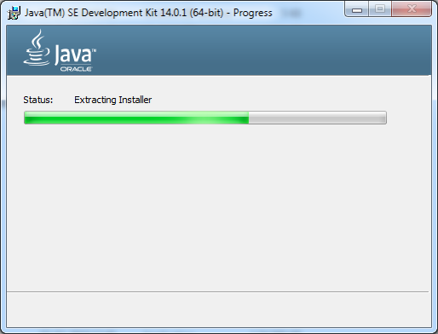
Installing JDK

Slide 26
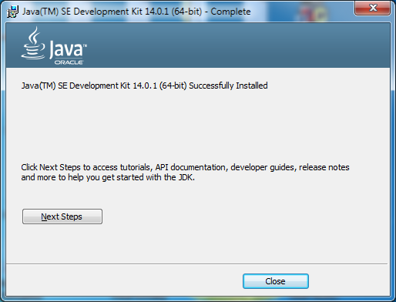
Installing JDK
If everything goes perfectly you will receive a message saying that installation is successful.

Slide 27
Verifying Installation
Go to the specified path, where you install your Java.
By default Java gets installed in C:\Program Files folder
There you will see a Java folder
Inside the Java folder you will see jdk-14.0.1 folder

Slide 28
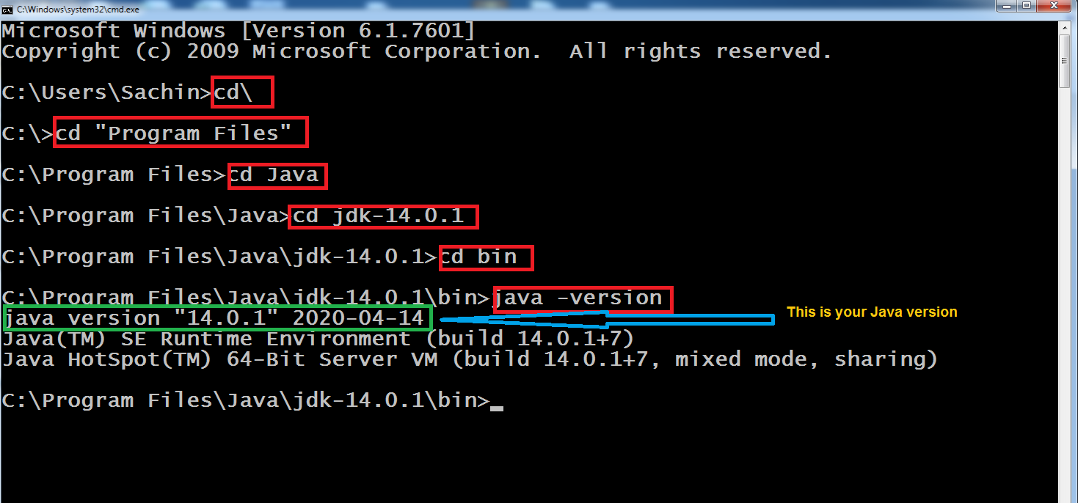
Verifying Installation
Go to start type cmd and open it by clicking on it and type the following command highlighted in red:

Slide 29

End Of Lecture 2
For any queries mail us @: scalive4u@gmail.com
Call us @ : 0755-4271659, 9826686245
Agenda for Third Lecture:
Writing First Java Code
Compilation Process And It’s Explanation
Executing The Code
Discussion About Some Important Errors
Some More Concepts

